Slide 1
a hip-hop network
-Let's find a rapper I might like!
20151309 Jin Yang

Slide 2
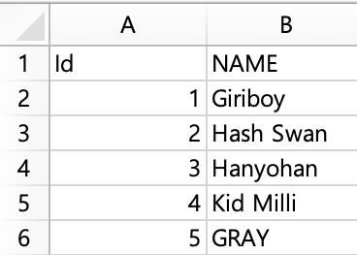
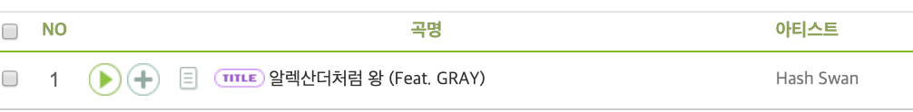
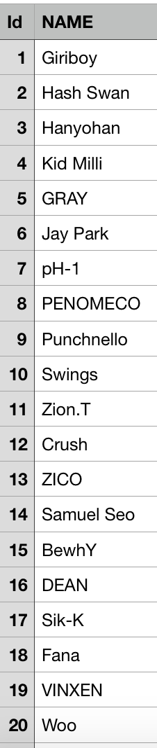
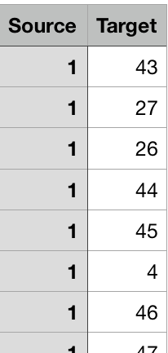
data collection
1. Search for the rapper's name on music streaming sites such as Melon.
2. Create a node list and an edge list with Excel.
- Node attribute : NAME, degree, centrality (degree, centrality are added during coding)
Edge attribute : Source(artist name), Target(featuring artist name), weight (Number of collaborations) (weight are added during coding)
3. Convert to csv file
Total of 318 nodes data and 1,118 edges data were collected.

Slide 3
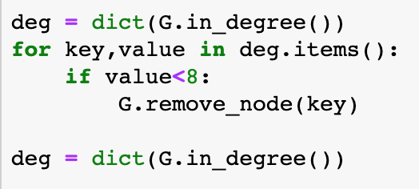
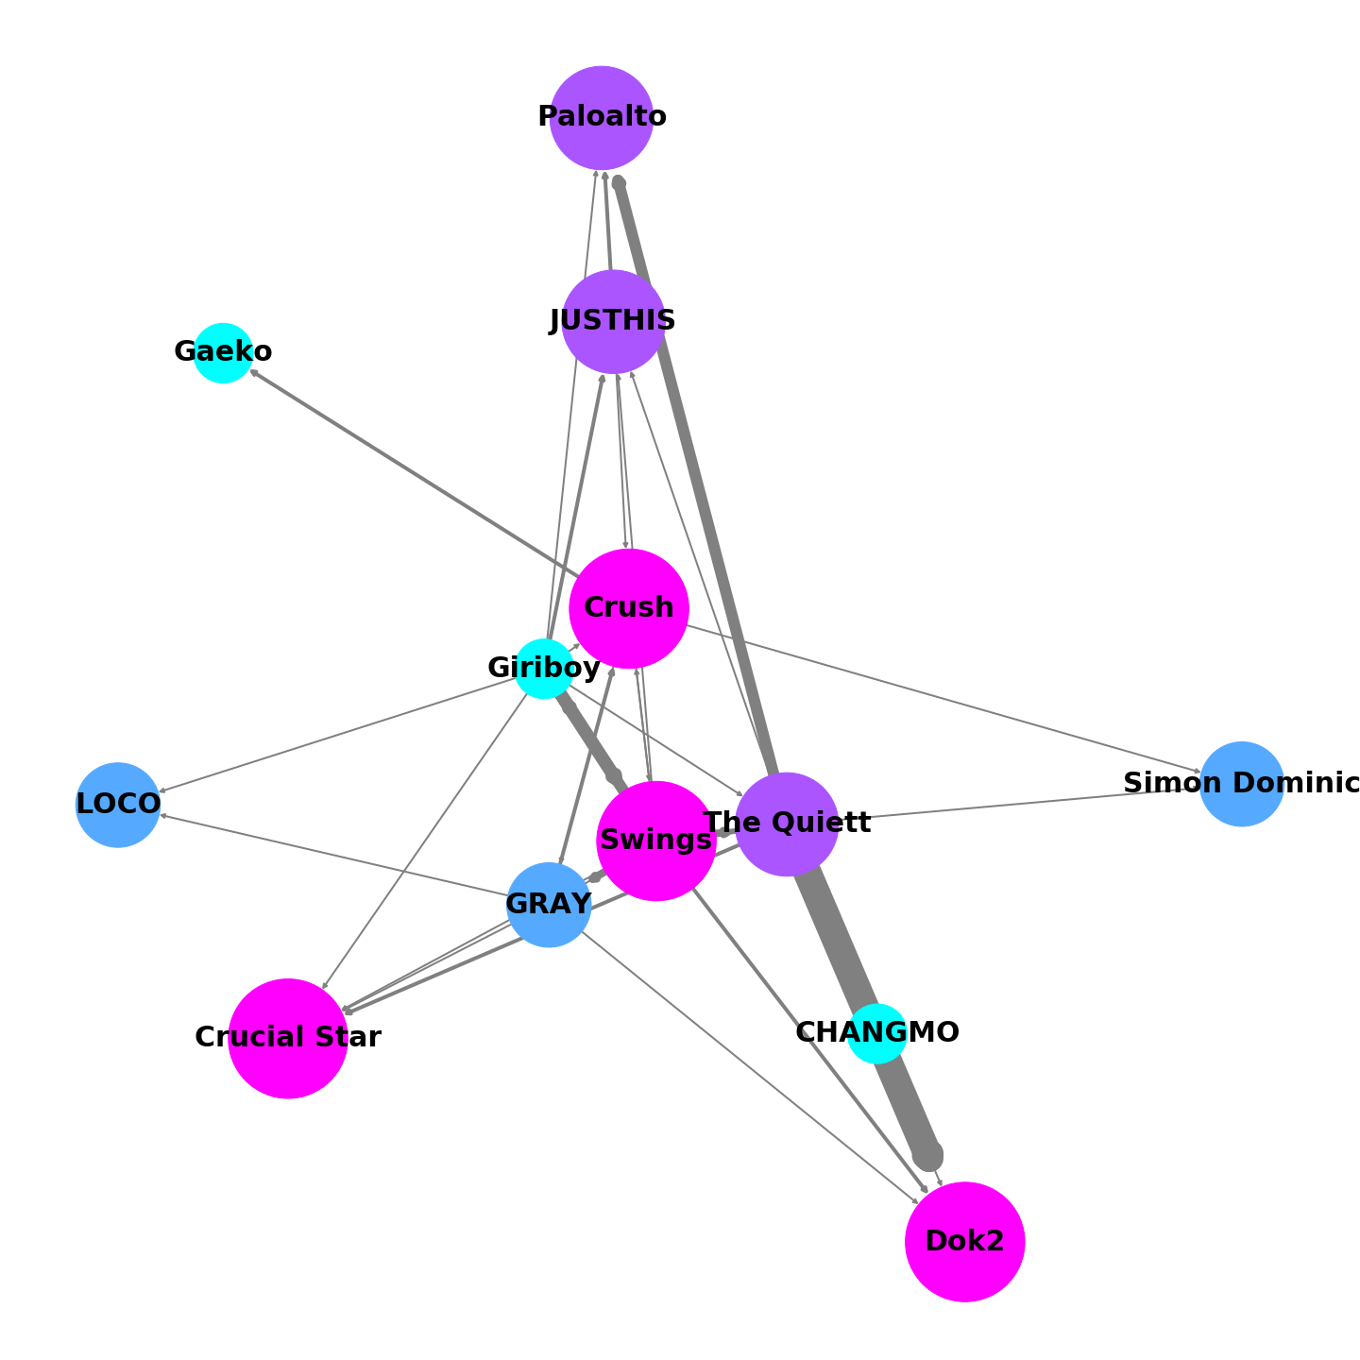
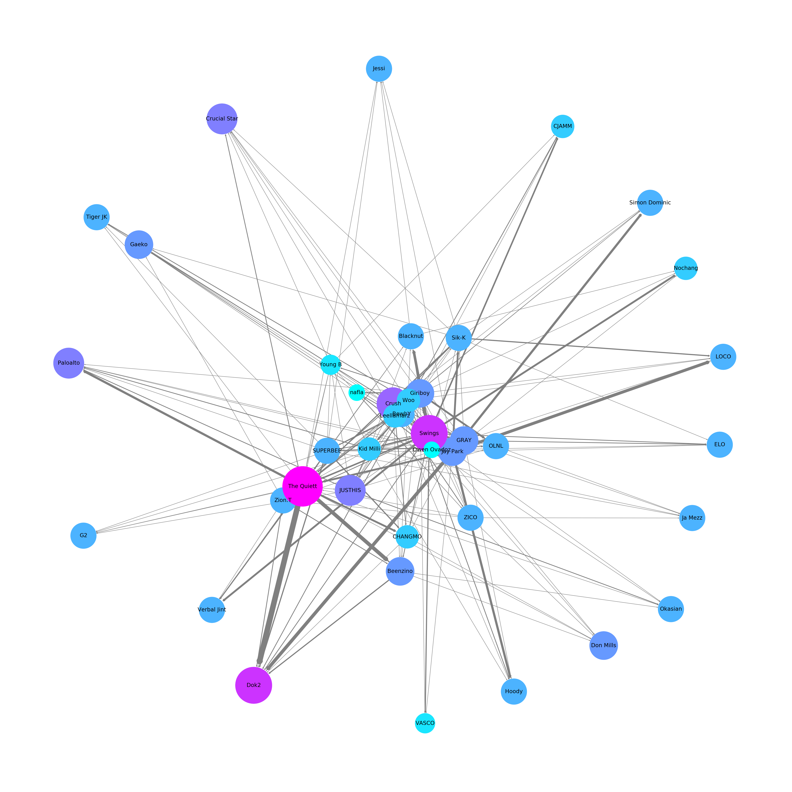
First Observation: The Most Active Rapper
Network of all data
Artist with feat. more than 4 times
Artist with feat. more than 7 times

Slide 4
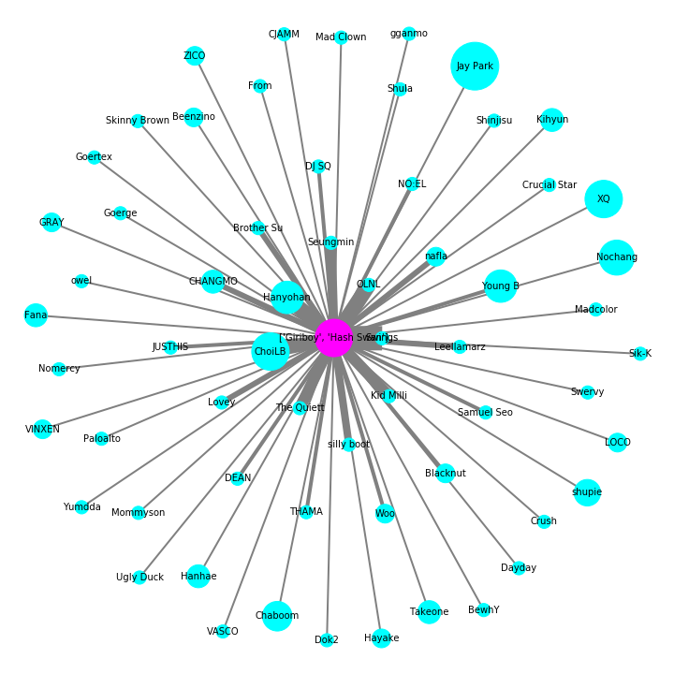
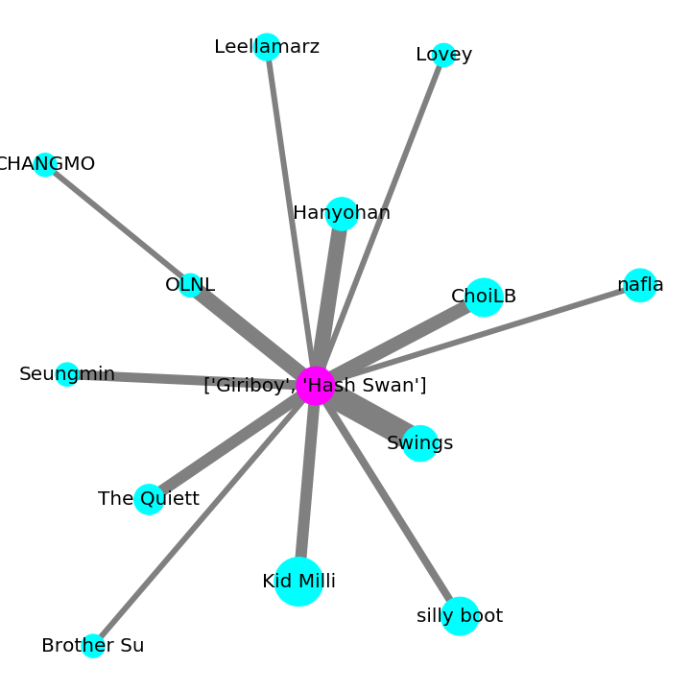
second Observation: find a rapper I might like
I like Giriboy and Hash Swan. Who is a similar artist?
Approach
1. Count the number of feat. with Giriboy and Hash Swan of other artists
2. Check artists who have frequent collaborations (feat.)

Slide 5
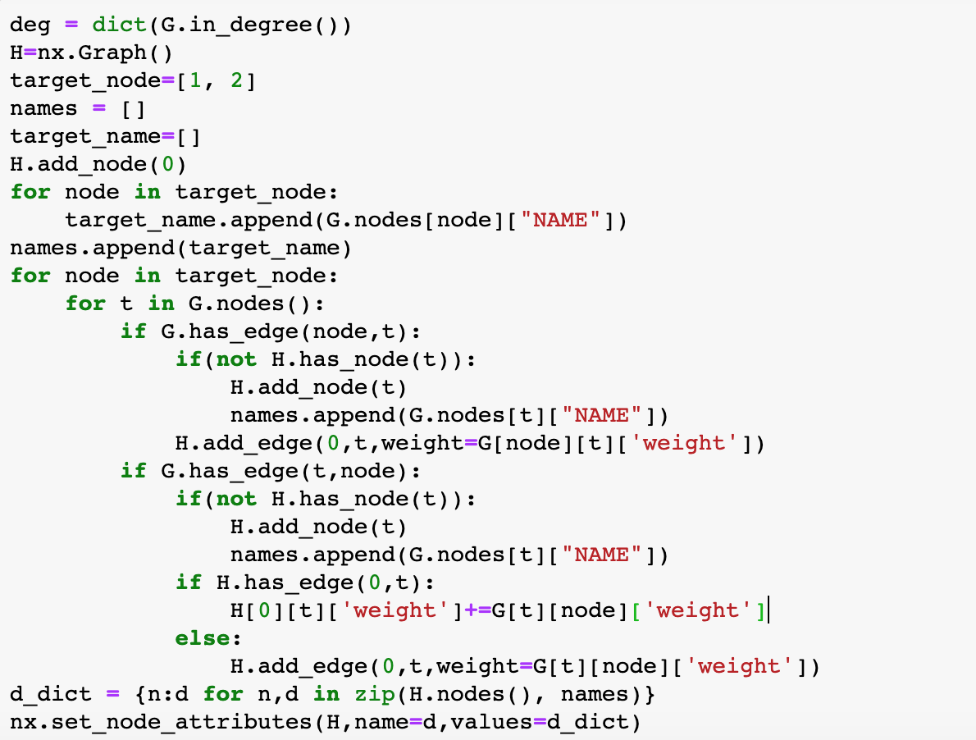
second Observation: find a rapper I might like
G is network of all data
Target_node : Id of my favorite rapper
If someone did feat. with Target_node, add an edge to the newly created graph H and update the weight.
Remove the rest, leaving only nodes with large weight.

Slide 6
Conclusion
You can find artists who do similar music based on your favorite singer information.
future works
Add function to reduce weight by using list of disliked singers
> More precise calculations available
Assign position by same crew or agency > Easier and more intuitive to understand the characteristics of each crew
…

